Slide 1

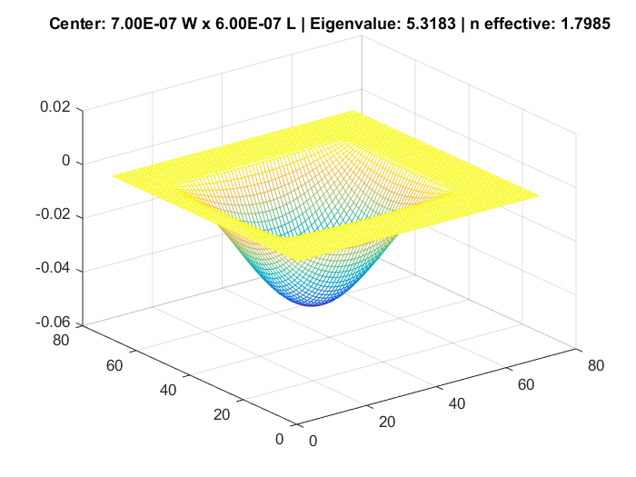
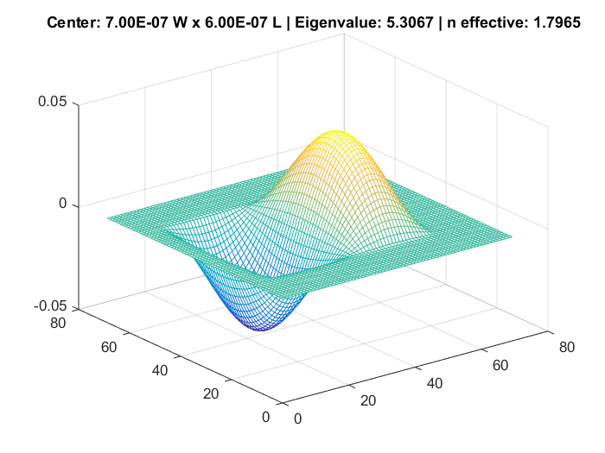
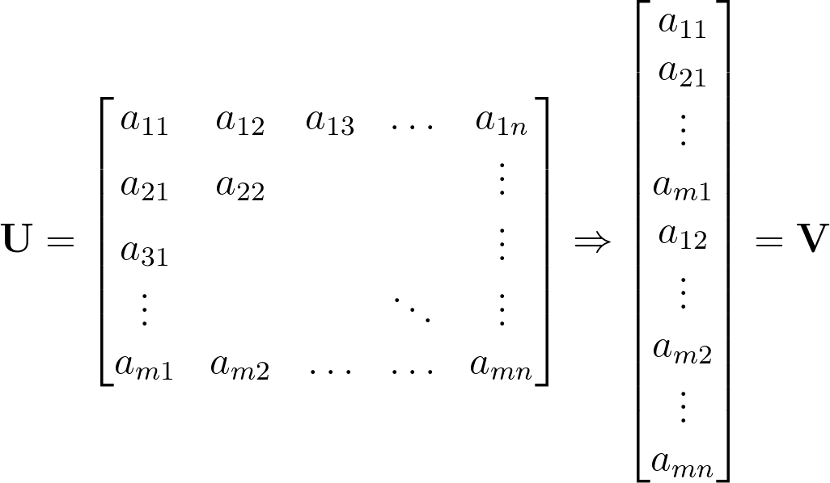
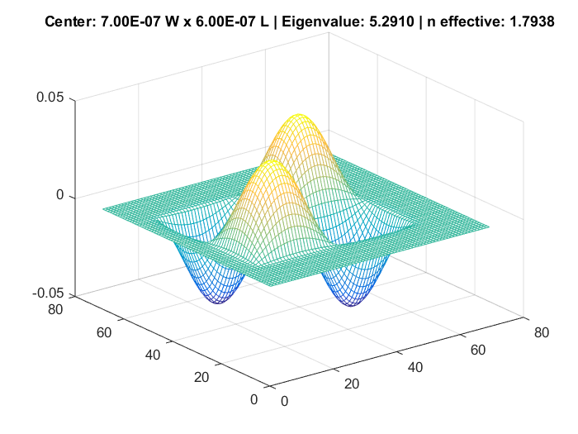
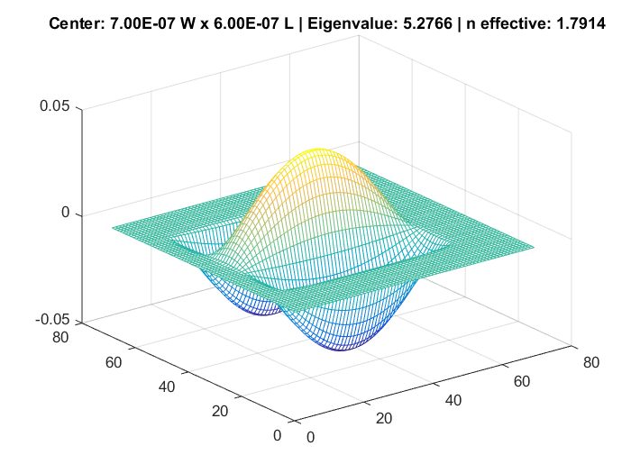
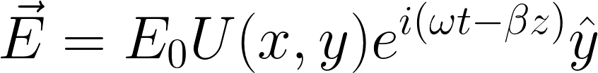


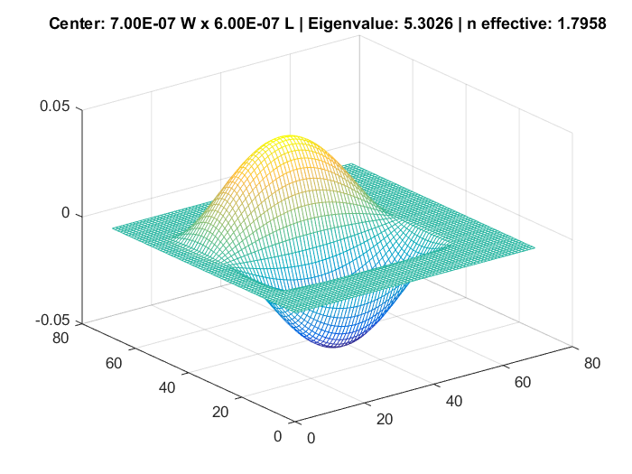
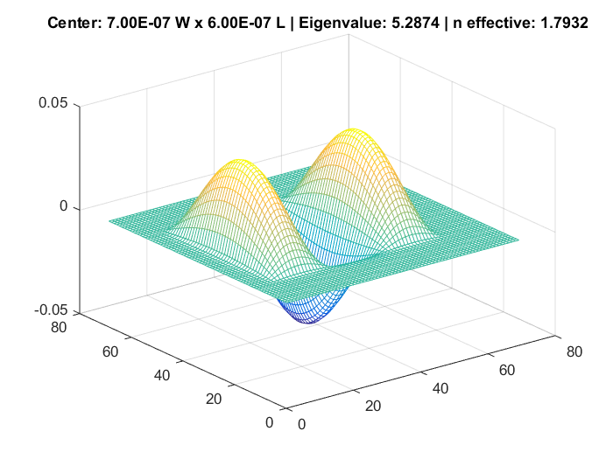
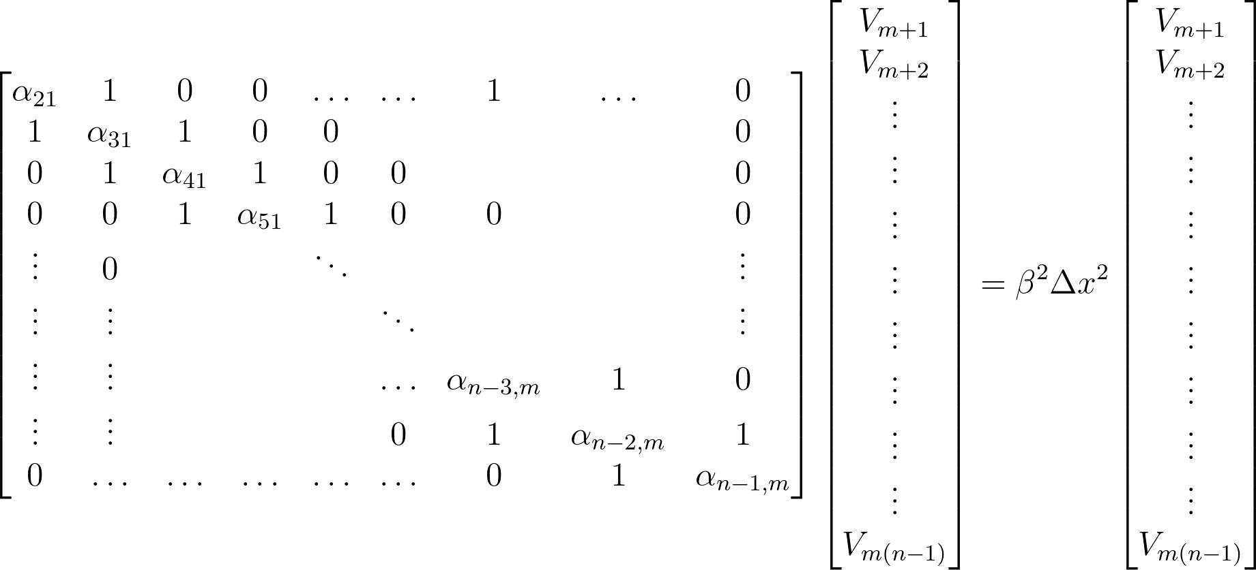
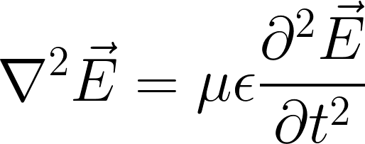
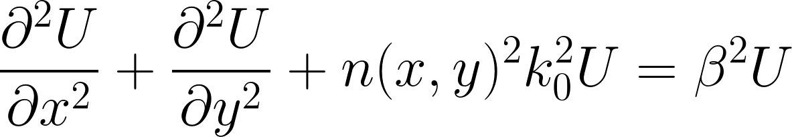
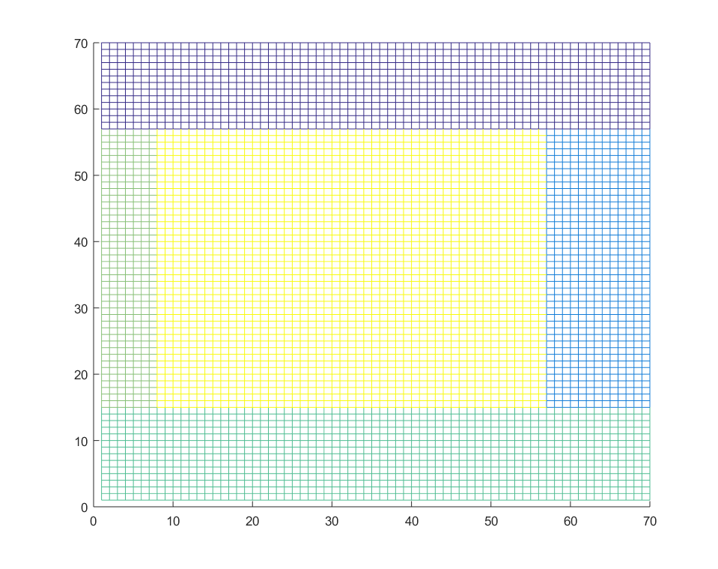

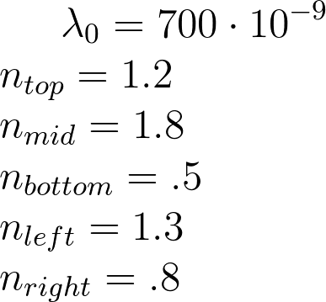
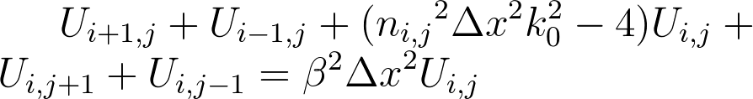
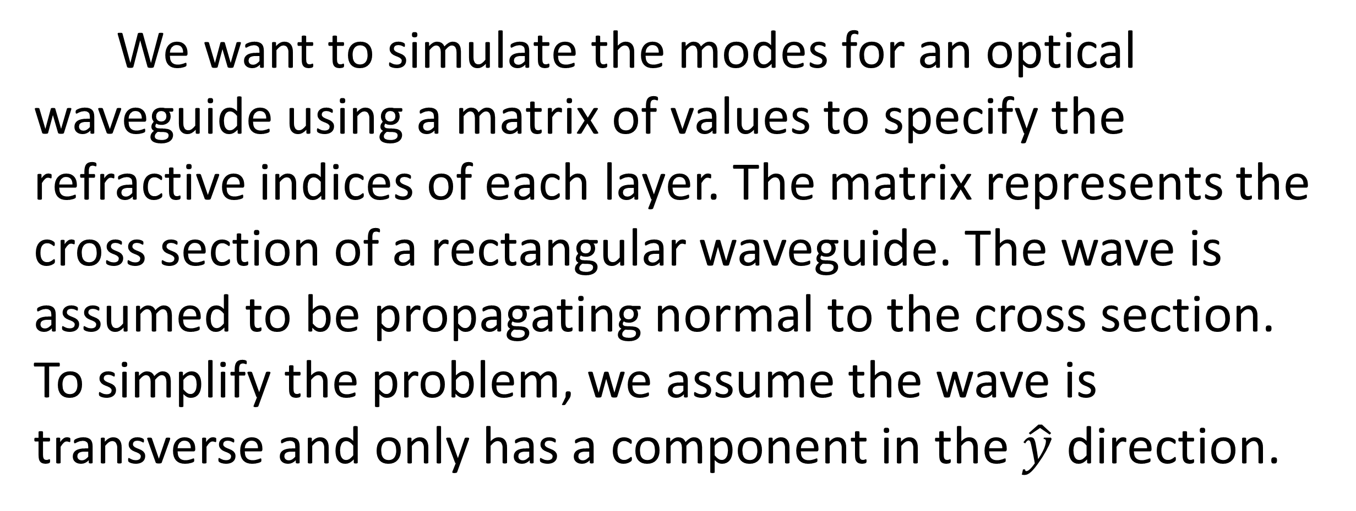
Simulating Modes for a Waveguide
Panya Sukphranee, Alex Small
Department of Physics and Astronomy, California State Polytechnic University, Pomona, 3801 West Temple Avenue, Pomona, CA 91768, USA, arsmall@cpp.edu
Idea
We “unwrap” the m-by-n computation window matrix, U, into a long column vector V.
We want to simulate the modes for an optical waveguide using a matrix of values to specify the refractive indices of each layer. The matrix represents the cross section of a rectangular waveguide. The wave is assumed to be propagating normal to the cross section. To simplify the problem, we assume the wave is transverse and only has a component in the $\hat{y}$ direction.
is the amplitude distribution function we discretize.
The relationships between points in the computation matrix U can be carried into V by constructing another matrix we’ll call the eigenMatrix, which is left-multiplied with V.
The exponential term contains the wave’s time dependence term and the propagation constant. The propagation constant, β, can be real or complex. β is real for guided waves and complex for evanescent waves.
The function above satisfies the Helmholtz Equation
Conclusions
Turning the wave equation into an eigenvalue problem is an efficient scheme for solving for modes. We used MATLAB to solve some arbitrary values. We imposed one constraint of the edge values equaling 0 for the above example.
The scheme can be extended to solve for transverse electric field vectors with x and y components. Then the transverse magnetic field can be calculated from that.
Becomes the following when discretized

